Slide 1

Emergency Assistance System

Slide 2
Problem Statement
Agenda
Solution Overview
Digital Twin
PoC
Actionable Insights

Slide 3
Objective
If there is an emergency situation occurs due to Car accident:
Based on the situation it may be very difficult for customers to reach out anyone for help.
If injuries are serious then the initial few hours after accident are very critical for their survival.
The more delay in assistance and help may case permanent / life long ailment or it may lead to death.

Slide 4
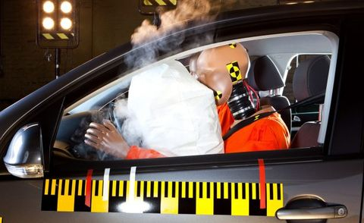
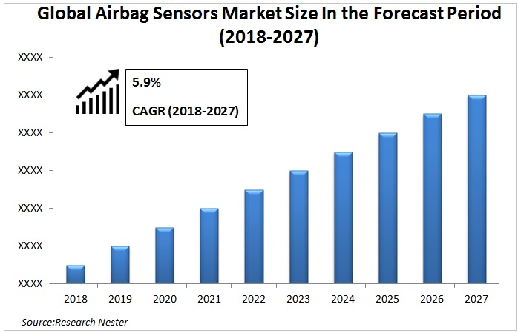
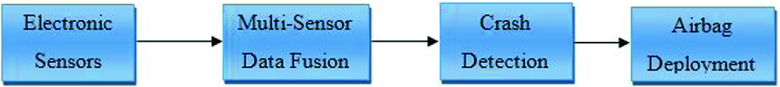

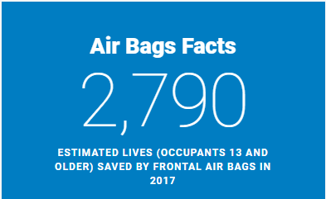
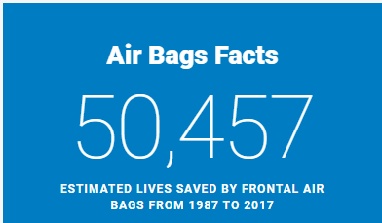
Airbags sensor data
Airbags
6 million
Average number of car accidents in the U.S. every year

Slide 5
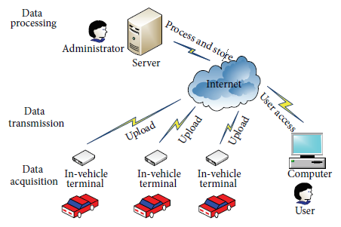
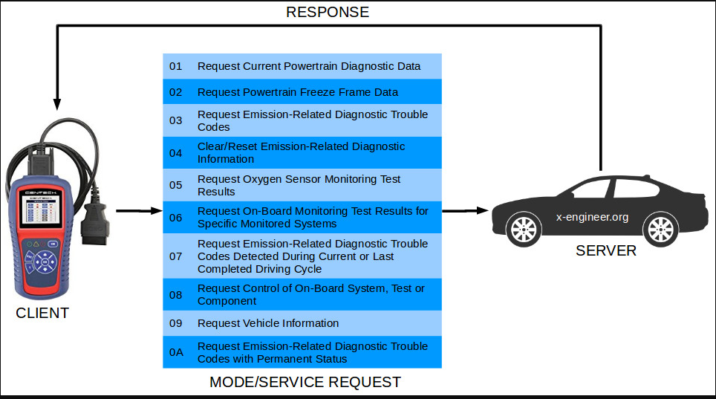
Car Networking Architecture

Slide 6
Solution Overview
Using Real-time streaming data generated from Airbag sensor, alert the Insurance company once Airbag is pushed upwards.
Immediately Insurance agent will contact and help Insured to avoid the uncertain situation.
By this way, they can avoid paying extra to the Insured and the Insured can also benefit from his toughest situation.
Based on the RTOBD (Real Time On Boarding diagnostics), Insurance company can understand the driving pattern and behavior of the owner and process claims based on the necessity. Also these details help them to tweak the premiums.

Slide 7
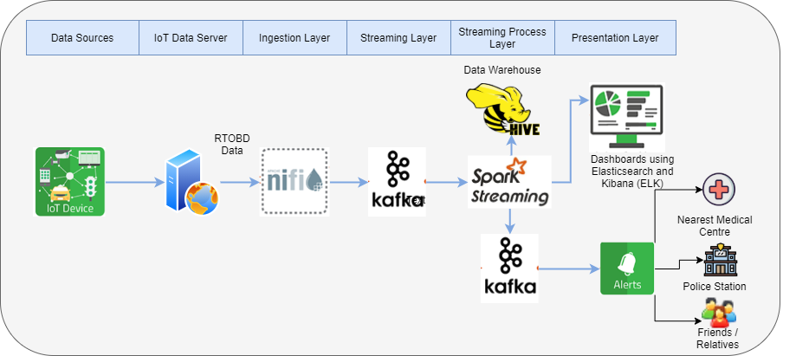
Data Streaming Architecture

Slide 8
Solution and Design
Nifi to fetch flow file from central fleet log server and persist in distributed messaging queue Kafka.
Spark Dataframe to read policy information from the RDBMS tables (Hive) such as policy, plan, customer, address, plan price, underwriting etc.
Spark Streaming read fleet data from Kafka for understanding the driving pattern based on speed, location, age, mileage, travel frequency, acceleration, speed braking.
For matching accident data with customer data, trigger an alert to Insurance company agent/rep to assist the customer.
Using Spark transformations, generate the insurance amount as per underwriting clarifications.
Spark persist data as wide tables in Elastic Search for real-time aggregation and visualization in Kibana.

Slide 9
Digital Twin

Slide 10
Ovrview
Emergency Assistance provided by Insurance Company automatically create Car Digital Twin. This can be used to alert the emergency services operator if an accident occurs and results in to car fuel pump to shut-down or airbags to activate.
The alert gives location details and also call stays open so that anyone in the vehicle or at the scene can talk to the operator.
Digital Twin operate on 24x7 basis and provide the assistance to drivers for risk prevention and also at emergency situation.

Slide 11
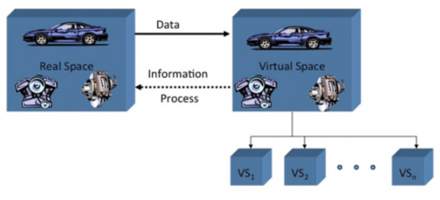
Digital Twin

Slide 12
Digital Twin
Digital twin is also used in electric vehicles. The e-cars can be paired with its digital twin.
IoT sensors are installed on the vehicle so that the sensors can send or receive information from its digital twin.
The data gathered from the sensors enables to keep a track of the working condition of the car and also detects problems early on in order to avoid expensive repairs.
For instance, the American automobile company Tesla makes use of the digital twin application in each of its vehicles.

Slide 13
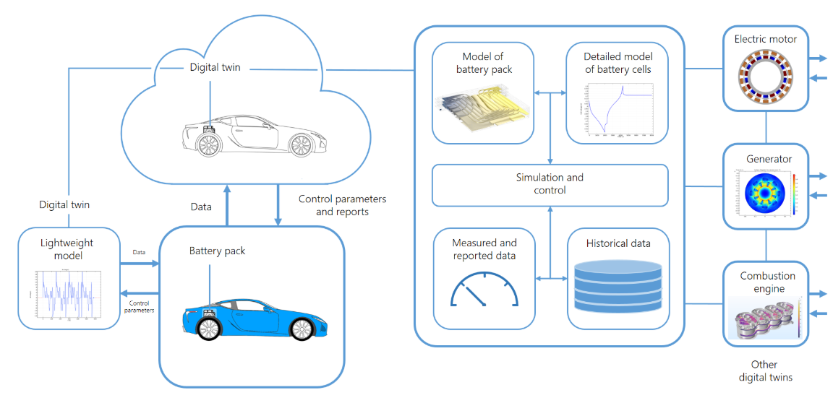
Digital Twin

Slide 14
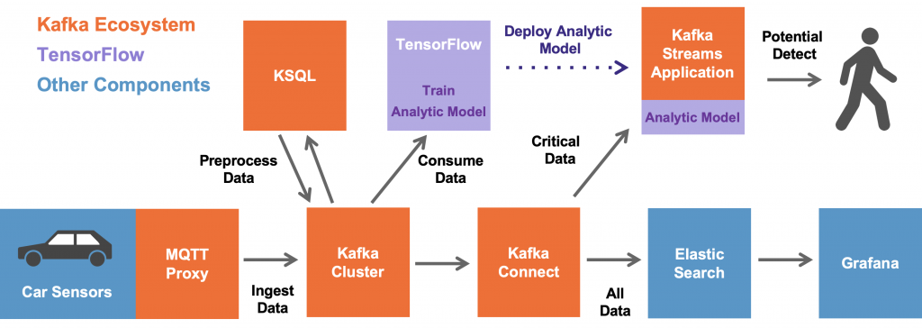
Apache Kafka as the Digital Twin
Notes:
https://www.kai-waehner.de/blog/2019/11/28/apache-kafka-industrial-iot-iiot-build-an-open-scalable-reliable-digital-twin/
https://www.kai-waehner.de/blog/2019/11/22/apache-kafka-automotive-industry-industrial-iot-iiot/

Slide 15
Apache Kafka as the Digital Twin
The data from cars is ingested and stored in the Kafka cluster, i.e. the digital twin, for further processing and real time analytics.
Kafka client applications consume the data for different use cases and in different speed:
Real time data pre-processing and data engineering using the data from the digital twin with Kafka Streams and KSQL / ksqlDB.
Streaming model training (i.e. without a data lake in the middle) with the Machine Learning / Deep Learning framework TensorFlow and its Kafka plugin (part of TensorFlow I/O). In our example, we train two neural networks: An unsupervised Autoencoder for anomaly detection and a supervised LSTM (Long Short Term Memory).
Model deployment for inference in real time on new car sensor events to predict potential failures in the motor engine.
Ingestion of the data into another batch system, database or data lake (Oracle, HDFS, Elastic, AWS S3, Google Cloud Storage, whatever).
Another consumer could be a real time, time series database like InfluxDB or TimescaleDB.

Slide 16
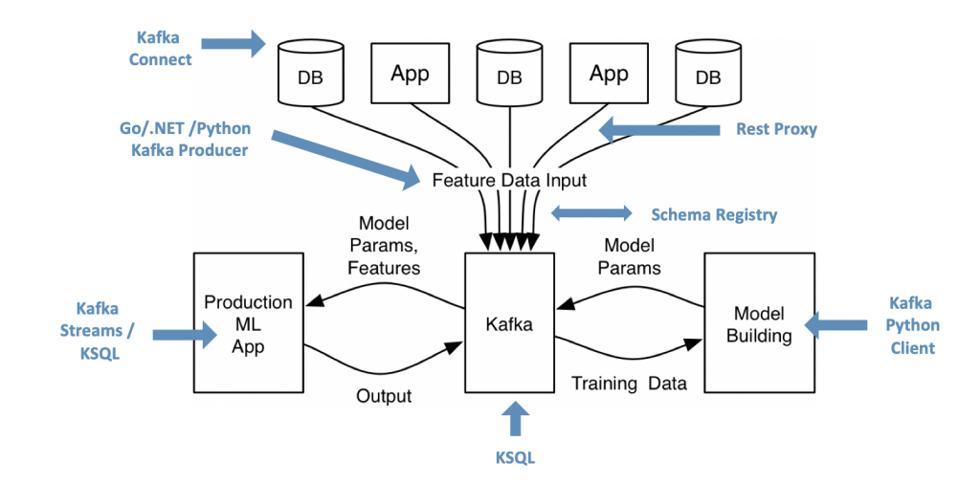
Machine Learning and Kafka in Automotive Use Cases
Notes:
https://www.kai-waehner.de/blog/2019/11/28/apache-kafka-industrial-iot-iiot-build-an-open-scalable-reliable-digital-twin/
https://www.kai-waehner.de/blog/2019/11/22/apache-kafka-automotive-industry-industrial-iot-iiot/

Slide 17
PoC

Slide 18
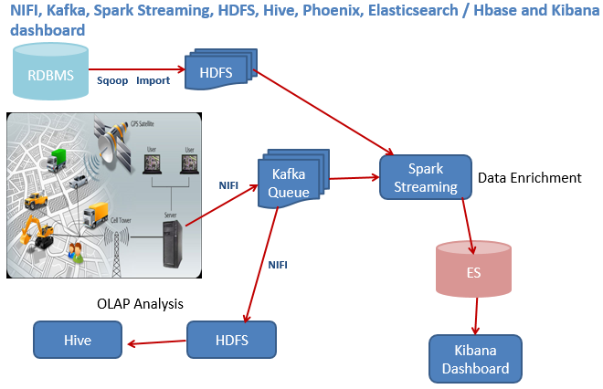
PoC Architecture

Slide 19
PoC Steps
Project Flow:
Batch:
1. Sqoop for injecting the drivers data from database.
2. HDFS for persisting the data for primary staging.
Realtime:
3. Run a linux shell script to simulate the realtime vehicle movement by reading data from events file and create smaller files.
4. NIFI data flow to read the data from the files created in step 3 and push the data to Kafka.
5.Spark Program to read the data from HDFS location where sqoop imported and read from Kafka, create dataframes, temporary views in spark and join the sqoop data with the kafka data and persist into Elastic search indices.
6. Kibana visualizations and dashboards created for reporting.

Slide 20
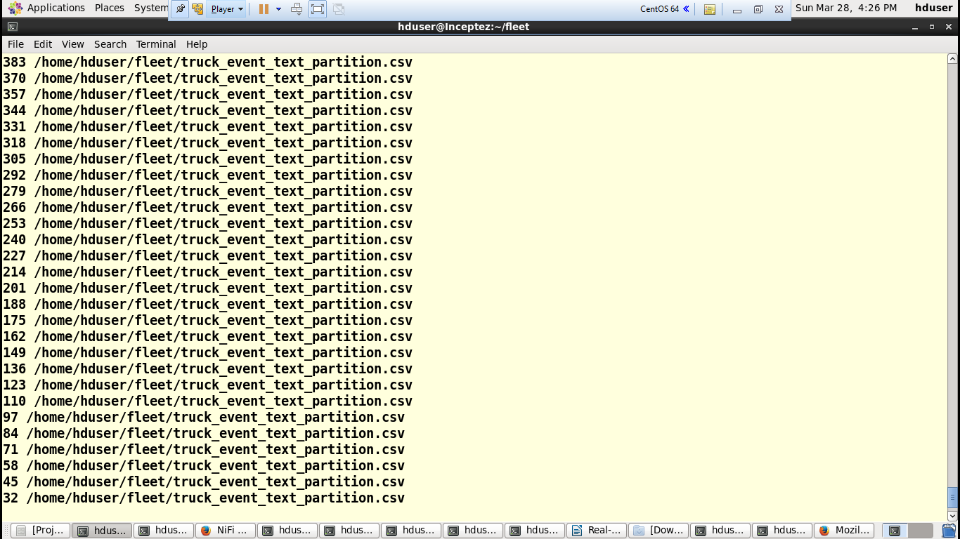
PoC – Streaming Data

Slide 21
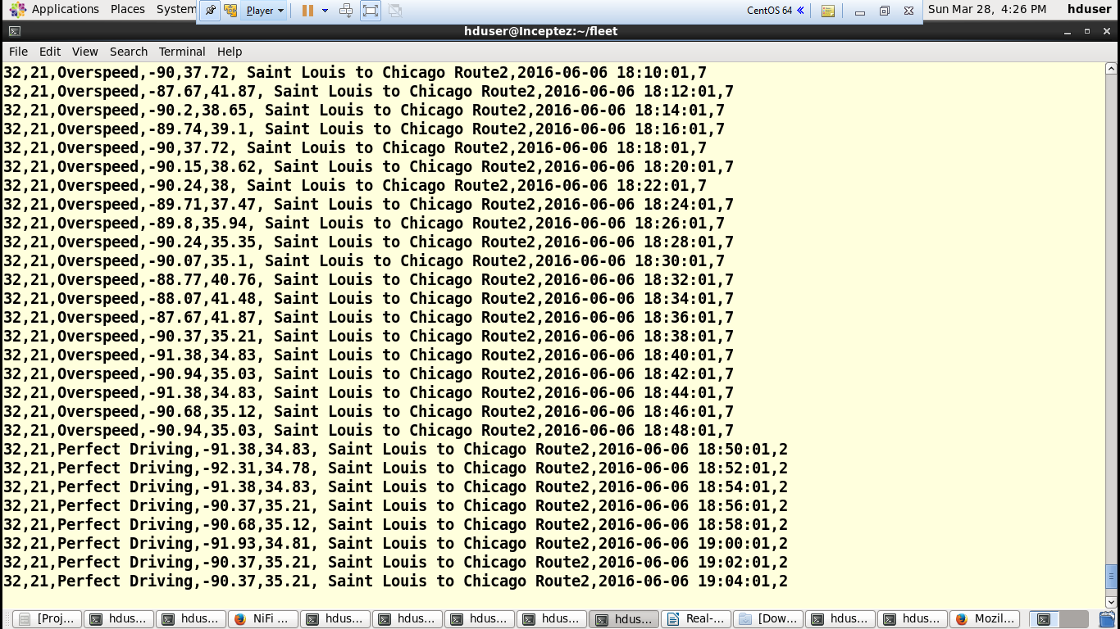
PoC – Streaming Data

Slide 22
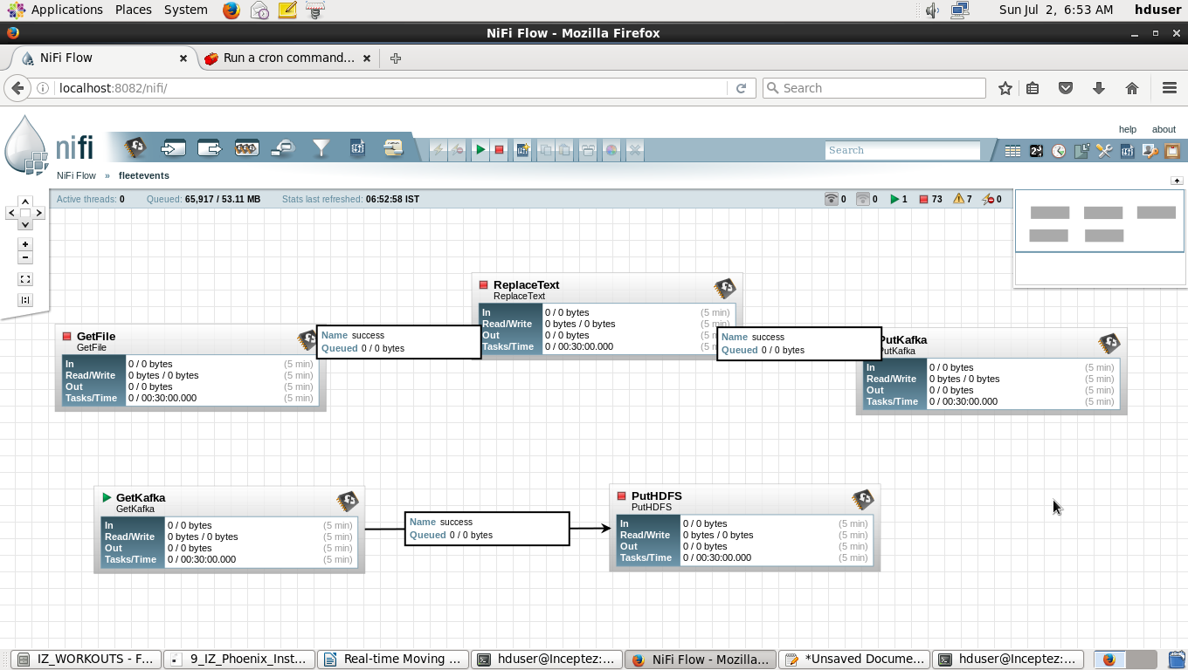
PoC – Nifi Flow

Slide 23
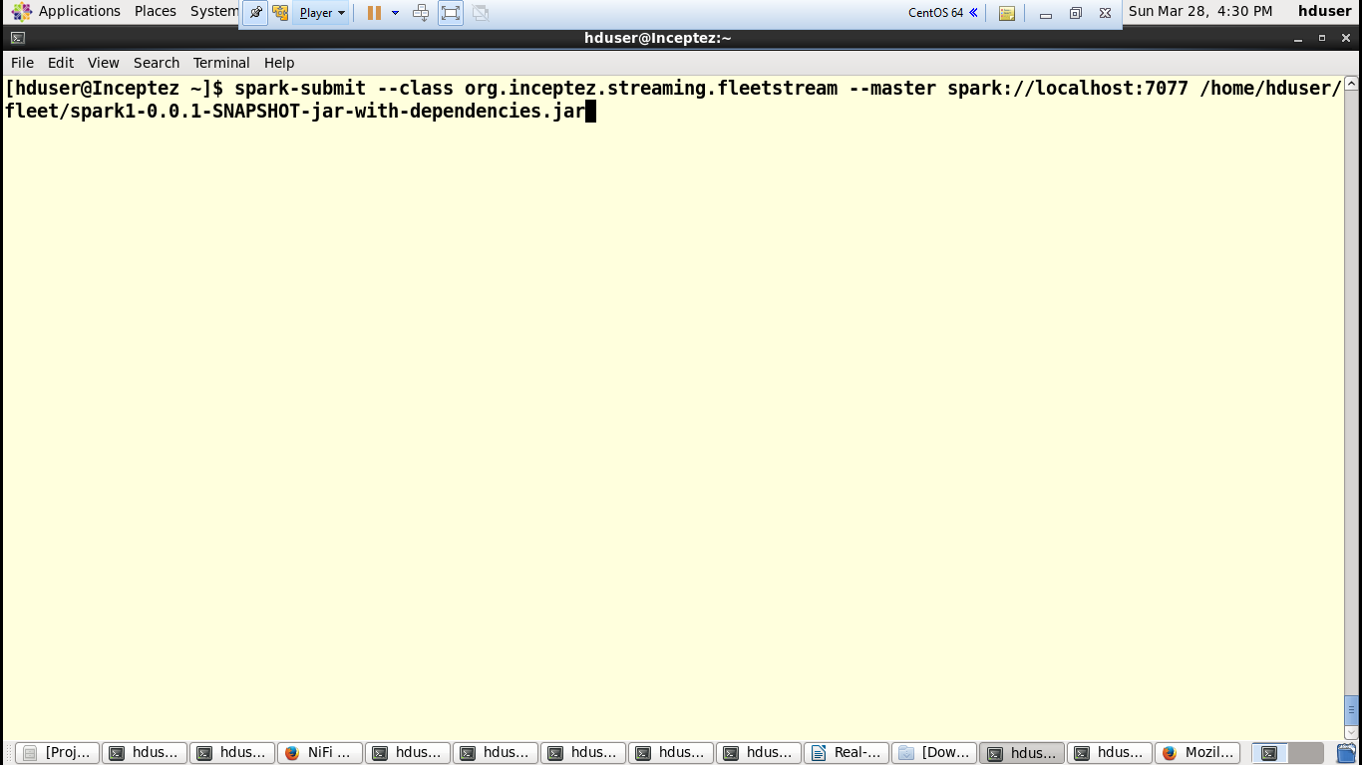
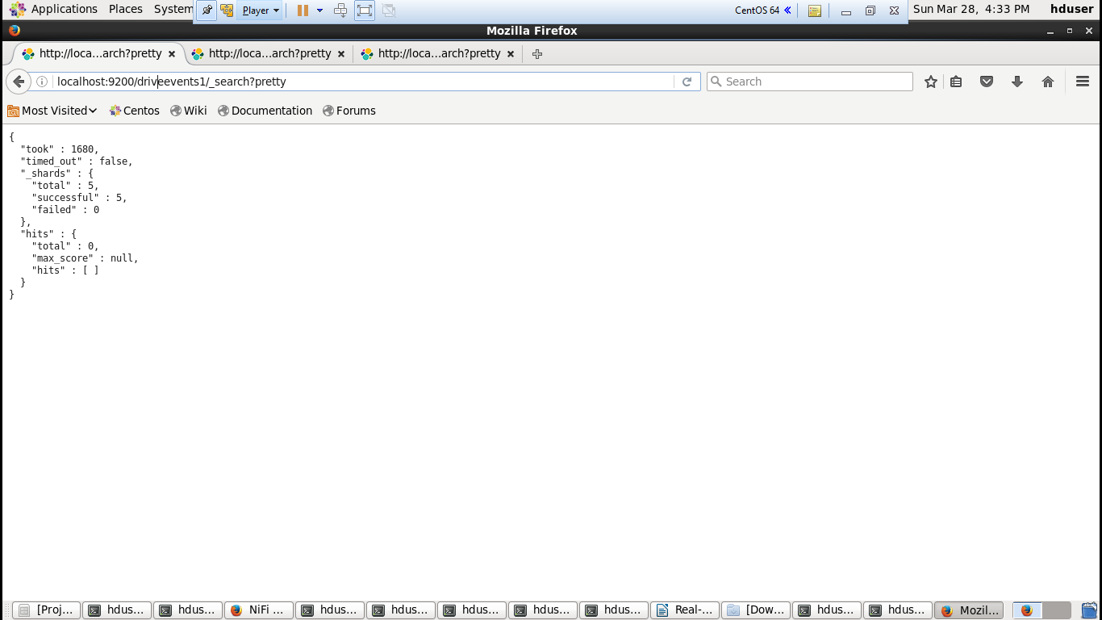
PoC – Spark Streaming and Elastic Search

Slide 24
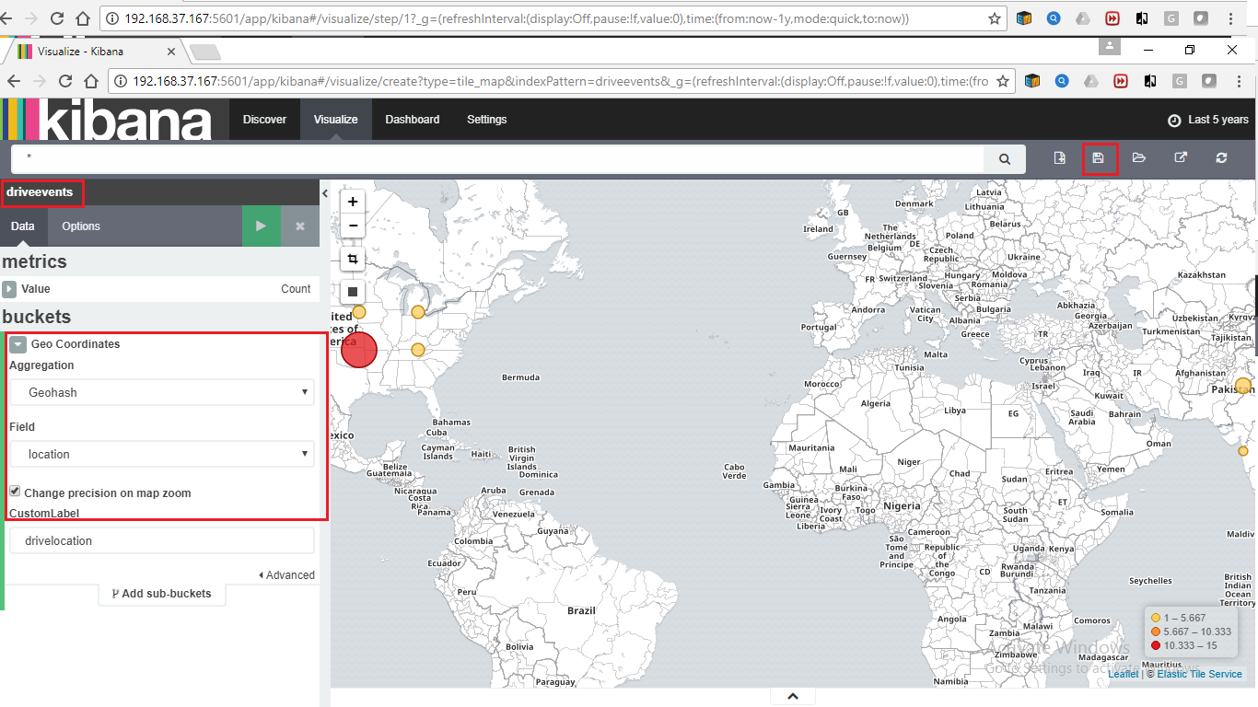
PoC – Kibana Tile Chart

Slide 25
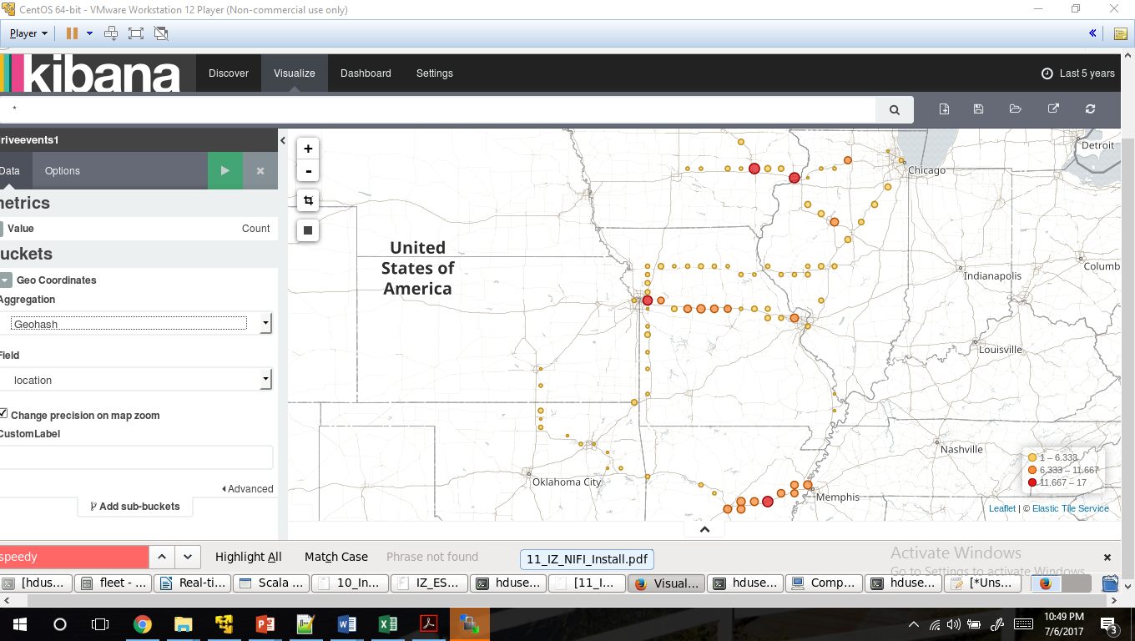
PoC – Kibana Tile Chart

Slide 26
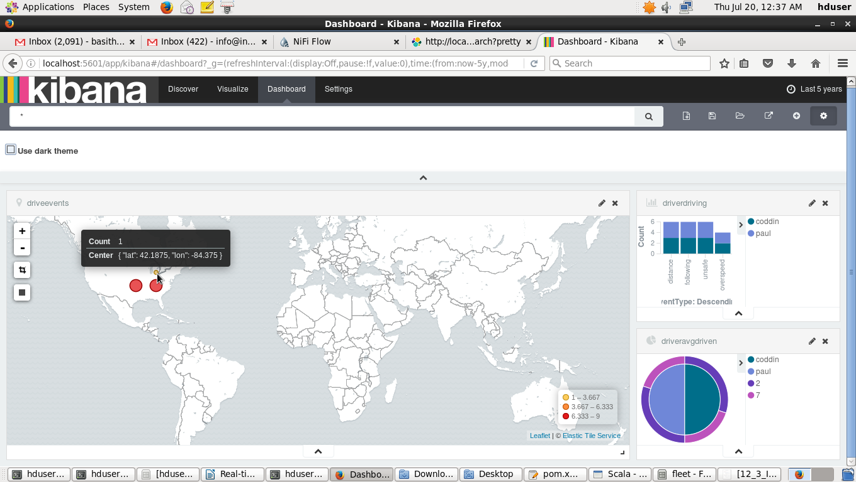
PoC – Kibana Dashboard

Slide 27
Actionable Insights

Slide 28
Discussion Points – Pro’s and Con’s
Who need to provide this emergency assistance?
Is it Vehicle Manufacturer? [YES]
Is it Insurance Company? [MAY BE, 50:50]
Is it life Insurance Company? [NO]
Is it Health Insurance Company? [NO]
Why Insurance Company need to take this risk?
Today Insurance Companies are tracking the Vehicles using Telematics devices to identify driving patterns and to tweak the Auto Insurance Premiums.
This is kind of extension to Telematics tracking to provide Emergency Assistance using Digital Twin technology.
This might be an additional service / coverage as like Towing and Labor.
Insurance Company can propose and charge this new coverage as similar to what Vehicle Manufacturers are doing.
What will happen if Insurance Company not provide this service?
Day by day organizations are becoming Data Centric.
Data Monopoly – There might be data monopoly by Vehicle Manufacturers if you enter into this data collection very late.
The research predicting that in future Drivers will prefer for need based short term Auto Insurance instead of Long-Term Insurance for a year. People expect more services as part of Short-Term Policy.
This will cause real competition and whoever provide more services (like Gaeco, Progressive,..etc) they might have more chances to increase their new business and also customer retention.

Slide 29
Thank You

